Slide 1
Mathematical Economics
Lecture 10

Slide 2
Plan
Eigenvalues and Eigenvectors
Diagonalization of Real Matrices
Diagonalization of Symmetric Real Matrices
Application to quadratic forms

Slide 3
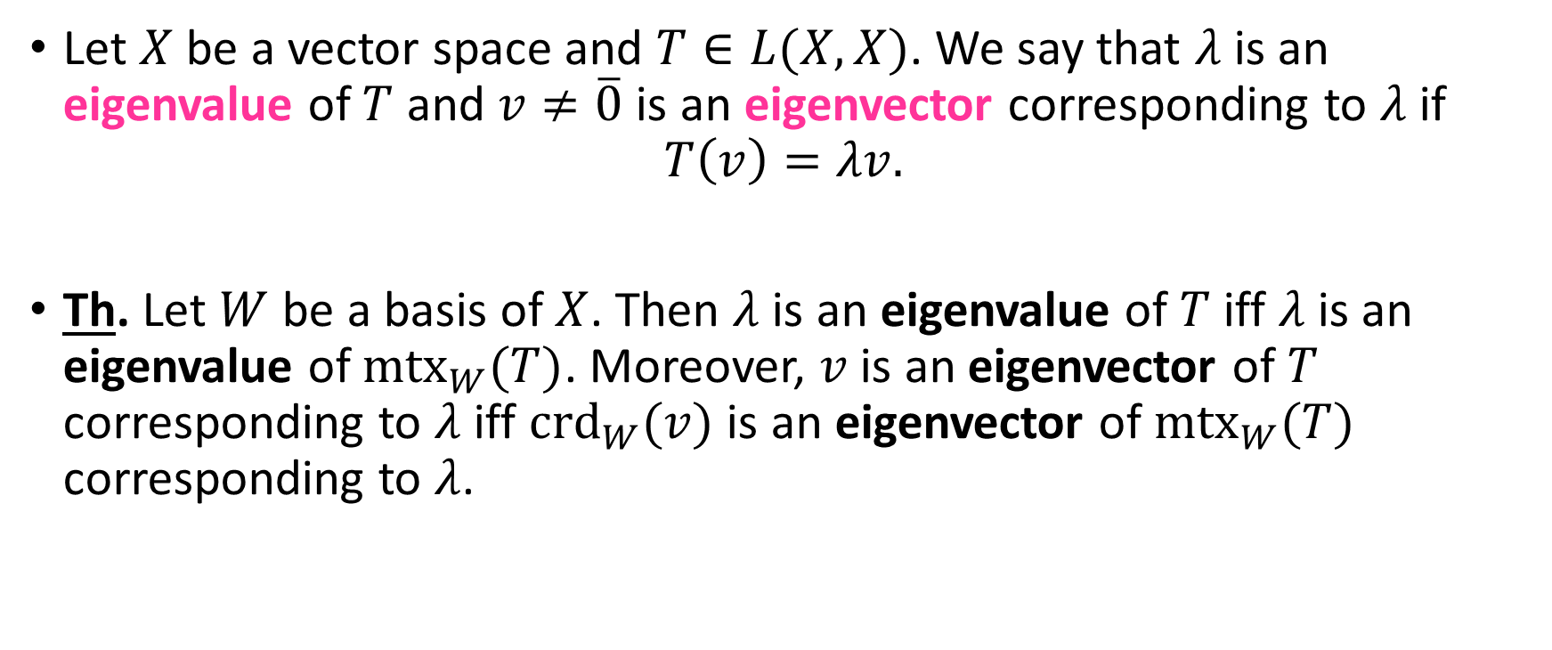
Eigenvalues and Eigenvectors
Let $X$ be a vector space and $T∈L(X,X)$. We say that $λ$ is an eigenvalue of $T$ and $v≠\overline{0}$ is an eigenvector corresponding to $λ$ if
$$T\left(v\right)=λv.$$
Th. Let $W$ be a basis of $X$. Then $λ$ is an eigenvalue of $T$ iff $λ$ is an eigenvalue of ${mtx}_{W}(T)$. Moreover, $v$ is an eigenvector of $T$ corresponding to $λ$ iff ${crd}_{W}(v)$ is an eigenvector of ${mtx}_{W}(T)$ corresponding to $λ$.

Slide 4
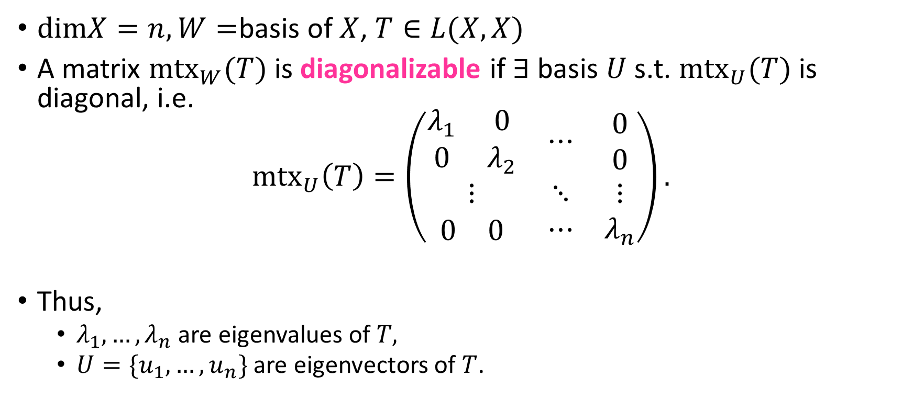
Diagonalization
$dimX=n,W=$basis of $X$, $T∈L(X,X)$
A matrix ${mtx}_{W}(T)$ is diagonalizable if $∃$ basis $U$ s.t. ${mtx}_{U}(T)$ is diagonal, i.e.
${mtx}_{U}\left(T\right)=\left(\begin{matrix}\begin{matrix}λ_{1} & 0 \\ 0 & λ_{2}\end{matrix} & ⋯ & \begin{matrix}0 \\ 0\end{matrix} \\ ⋮ & ⋱ & ⋮ \\ \begin{matrix}0 & 0\end{matrix} & ⋯ & λ_{n}\end{matrix}\right).$
Thus,
$λ_{1},…,λ_{n}$ are eigenvalues of $T,$
$U=\{u_{1},…,u_{n}\}$ are eigenvectors of $T$.

Slide 5
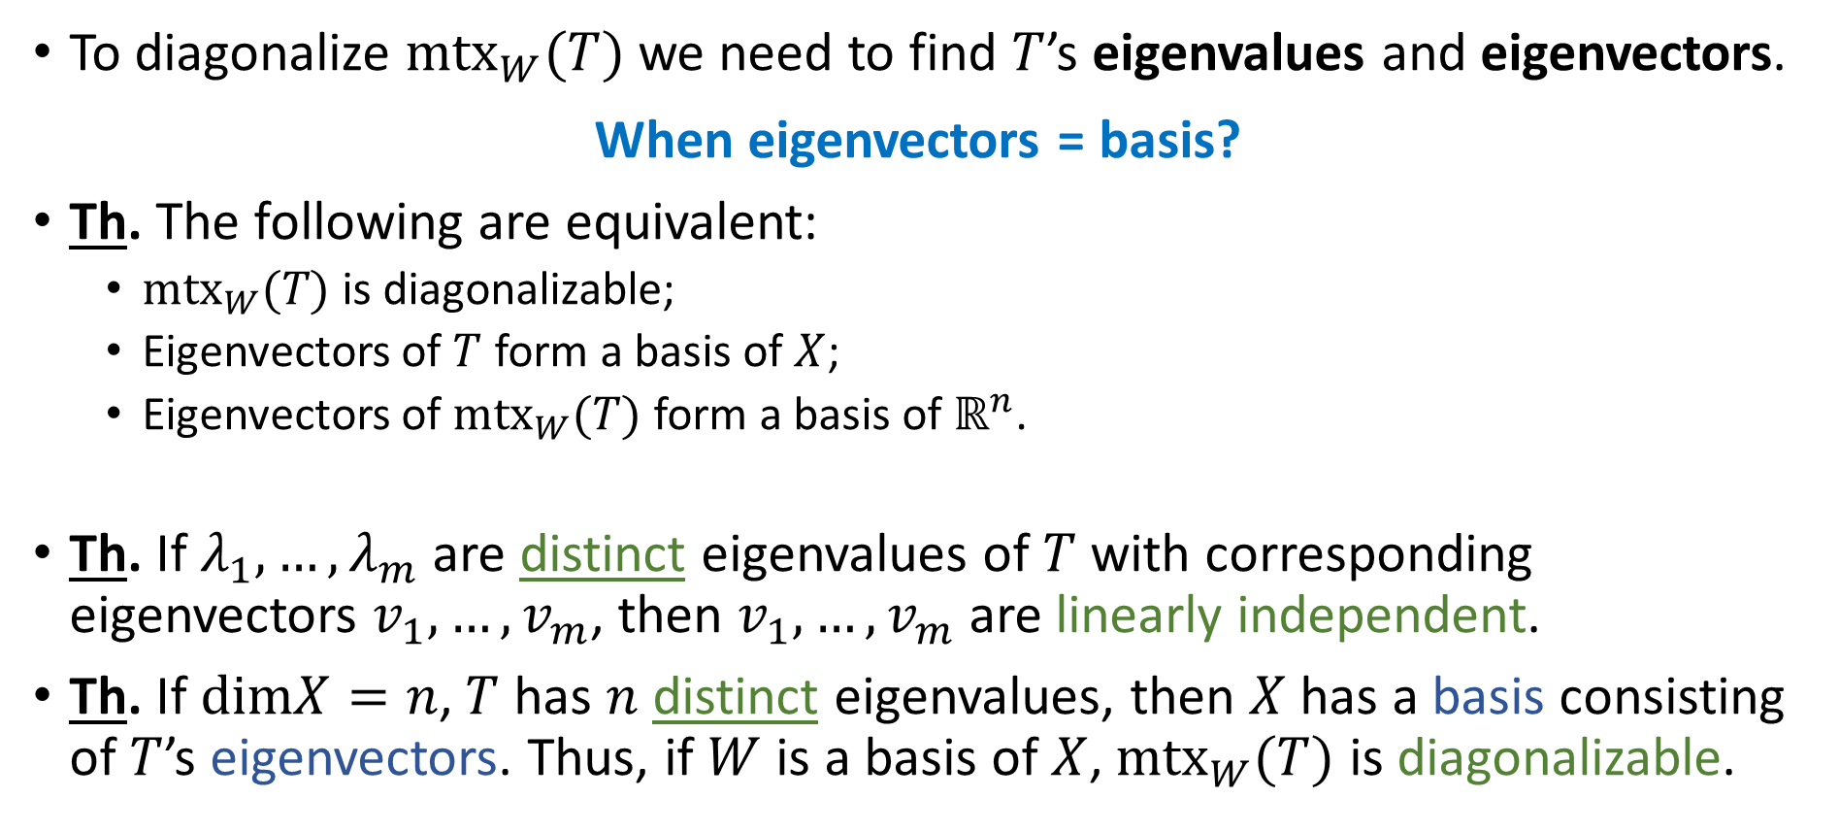
Diagonalization (cont.)
To diagonalize ${mtx}_{W}(T)$ we need to find $T$’s eigenvalues and eigenvectors.
When eigenvectors = basis?
Th. The following are equivalent:
${mtx}_{W}(T)$ is diagonalizable;
Eigenvectors of $T$ form a basis of $X$;
Eigenvectors of ${mtx}_{W}(T)$ form a basis of $ℝ^{n}$.
Th. If $λ_{1},…,λ_{m}$ are distinct eigenvalues of $T$ with corresponding eigenvectors $v_{1},…,v_{m}$, then $v_{1},…,v_{m}$ are linearly independent.
Th. If $dimX=n$, $T$ has $n$ distinct eigenvalues, then $X$ has a basis consisting of $T$’s eigenvectors. Thus, if $W$ is a basis of $X$, ${mtx}_{W}(T)$ is diagonalizable.

Slide 6
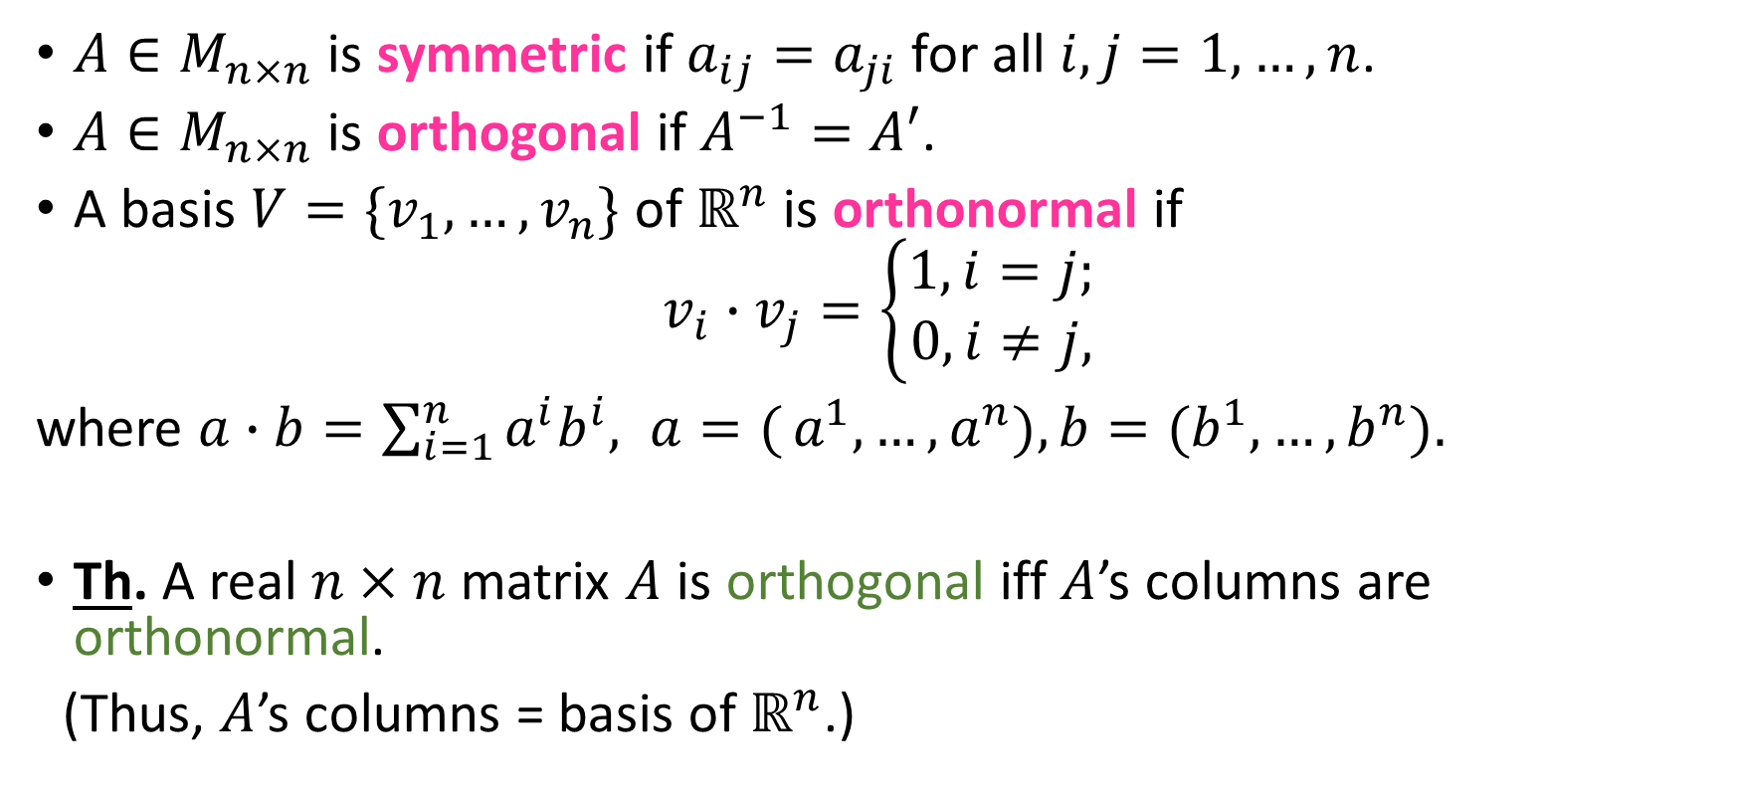
Symmetric Real Matrices
$A∈M_{n×n}$ is symmetric if $a_{ij}=a_{ji}$ for all $i,j=1,…,n$.
$A∈M_{n×n}$ is orthogonal if $A^{−1}=A′$.
A basis $V=\{v_{1},…,v_{n}\}$ of $ℝ^{n}$ is orthonormal if
$$v_{i}∙v_{j}=\left\{\begin{aligned}1, i=j; \\ 0, i≠j,\end{aligned}\right.$$
where $a∙b=\sum_{i=1}^{n}{a^{i}b^{i}, a=(}a^{1},…,a^{n}), b=(b^{1},…,b^{n}).$
Th. A real $n×n$ matrix $A$ is orthogonal iff $A$’s columns are orthonormal.
(Thus, $A$’s columns = basis of $ℝ^{n}$.)

Slide 7
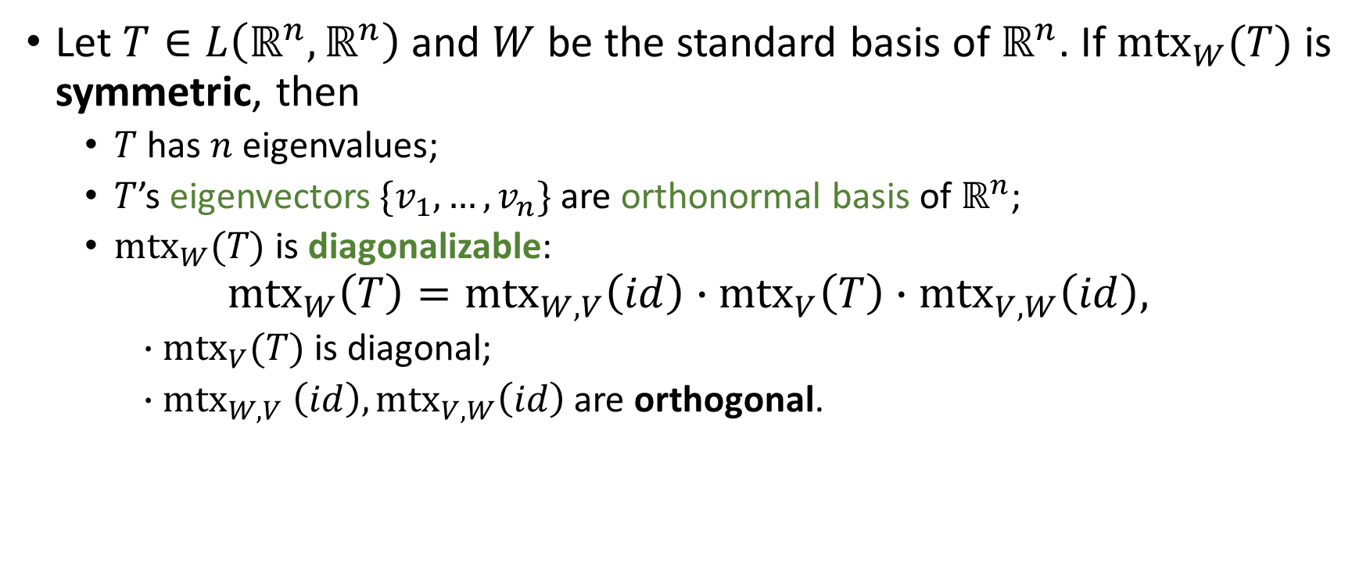
Diagonalization of Symmetric Real Matrices
Let $T∈L\left(ℝ^{n},ℝ^{n}\right)$ and $W$ be the standard basis of $ℝ^{n}$. If ${mtx}_{W}(T)$ is symmetric, then
$T$ has $n$ eigenvalues;
$T$’s eigenvectors $\{v_{1},…,v_{n}\}$ are orthonormal basis of $ℝ^{n}$;
${mtx}_{W}(T)$ is diagonalizable:
$${mtx}_{W}\left(T\right)={{mtx}_{W,V}\left(id\right)∙mtx}_{V}\left(T\right)∙{mtx}_{V,W}\left(id\right),$$
$∙{mtx}_{V}(T)$ is diagonal;
${∙mtx}_{W,V}\left(id\right),{mtx}_{V,W}\left(id\right)$ are orthogonal.

Slide 8
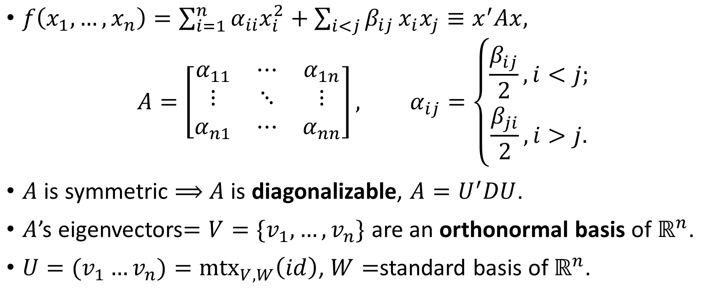
Quadratic Forms
$f\left(x_{1},…,x_{n}\right)=\sum_{i=1}^{n}{α_{ii}x_{i}^{2}}+\sum_{i<j}{β_{ij}}x_{i}x_{j}≡x^{′}Ax,$
$$A=\left[\begin{matrix}α_{11} & ⋯ & α_{1n} \\ ⋮ & ⋱ & ⋮ \\ α_{n1} & ⋯ & α_{nn}\end{matrix}\right], α_{ij}=\left\{\begin{aligned}\frac{β_{ij}}{2}, i<j; \\ \frac{β_{ji}}{2},i>j.\end{aligned}\right.$$
$A$ is symmetric $⟹$ $A$ is diagonalizable, $A=U^{′}DU$.
$A$’s eigenvectors$=V=\{v_{1},…,v_{n}\}$ are an orthonormal basis of $ℝ^{n}$.
$U=(v_{1}…v_{n})={mtx}_{V,W}\left(id\right)$, $W=$standard basis of $ℝ^{n}$.

Slide 9

Quadratic Forms (cont.)
$∀x∈ℝ^{n}: x=\sum_{i=1}^{n}{β_{i}v_{i}}, β_{i}=x∙v_{i}$
$f\left(x\right)=x^{′}Ax=\left(β_{1},…,β_{n}\right)D\left(\begin{matrix}β_{1} \\ ⋮ \\ β_{n}\end{matrix}\right)=\sum_{i=1}^{n}{λ_{i}β_{i}^{2}},$
where $D=\left(\begin{matrix}\begin{matrix}λ_{1} & 0 \\ 0 & λ_{2}\end{matrix} & ⋯ & \begin{matrix}0 \\ 0\end{matrix} \\ ⋮ & ⋱ & ⋮ \\ \begin{matrix}0 & 0\end{matrix} & ⋯ & λ_{n}\end{matrix}\right)$.

